Slide 1


Bank marketing - EDA Mini capstone project
Naga Lakshmi . P

Slide 2
Introduction:
Bank Marketing Dataset
The data is related with direct marketing campaigns of a Portuguese banking institution. It contains information about all the customers who were contacted during a particular year to open term deposit accounts.
Aim of the project
To promote term deposits among the customers.

Slide 3

Data Exploration:
Variables | Description
age | age of the client
job | type of job admin
marital | marital status
education | client education
default | Does the customer have credit in default?
balance | credit card balance of the client
housing | Does the customer have a housing loan?
loan | Does the customer have a personal loan?
contact | contact communication type
day | last contact day of the month
month | last contact month of year
duration | last contact duration, in seconds.
campaign | Number of contacts performed during this campaign and for this client includes last contact
pdays | Number of days that passed by after the client was last contacted from a previous campaign
previous | number of contacts performed before this campaign and for this client
poutcome | outcome of the previous marketing campaign
y(target variable) | has the client subscribed to a term deposit?
Imported python libraries
Loaded the dataset
Checked the size and information about the dataset
Client data
Campaign contact information for the client
Checked the missing values
Statistical summery of dataset
“pdays” (-1 means client was not previously contacted)

Slide 4

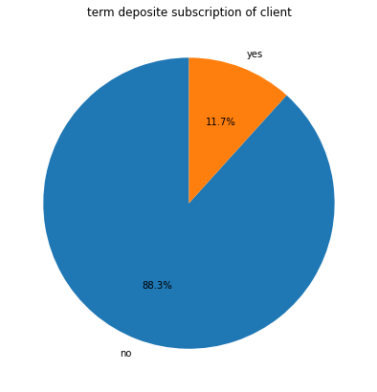
Data Visualization
Distribution of target categorical variable “y”
Target variable:
“y” (term deposit subscription)
Yes – 11.7%
No – 88.3%

Slide 5
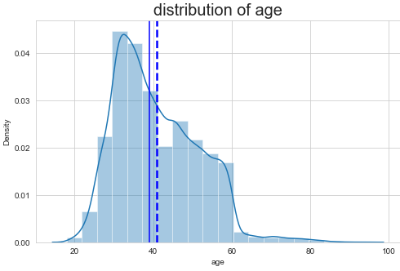
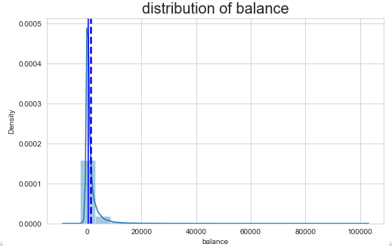
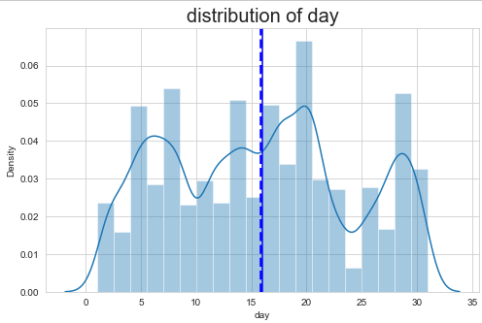
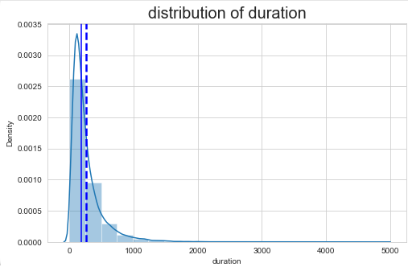
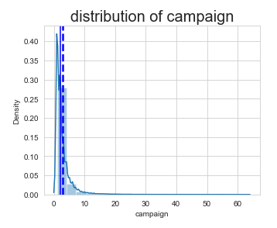
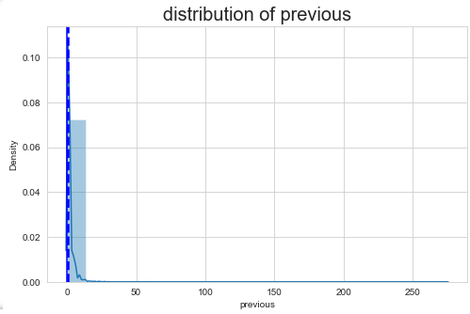
Distribution of numerical variables
Distribution of ‘age’ variable seems normal distributed but sightly skewed towards right side
Distribution of ‘balance’ variable is highly right skewed
Variable ‘day’ is normally distributed
Distribution of ‘duration’ variable is completely right skewed
Distribution of ‘campaign’ variable is highly right skewed
Distribution of ‘previous’ variables are also completely right skewed

Slide 6
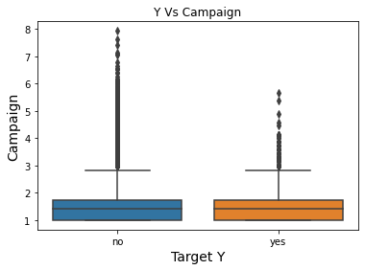
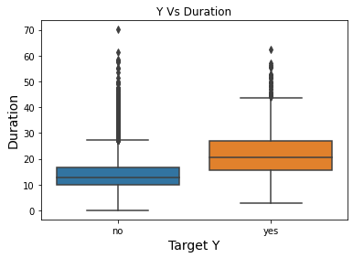
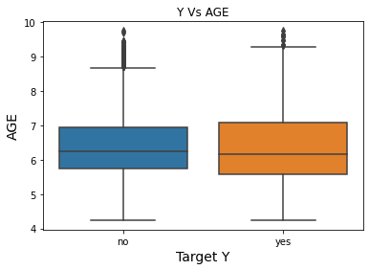
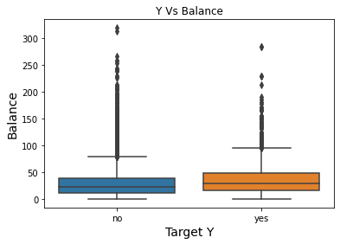
Handling the skewed data
By using Transformation methods tried to transform the data into normal distribution
After transformation still skewness is there because of outliers present in the data
Observing the outliers by using Boxplot and treating the outliers using IQR method

Slide 7
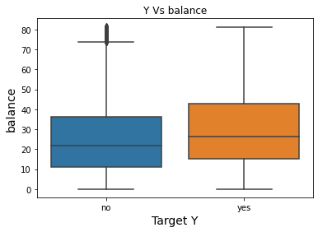
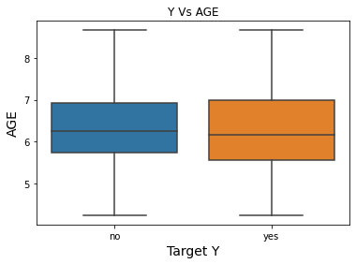
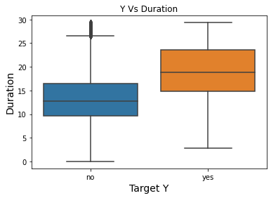
Finding Patterns between the Numerical variables and target variable
Y (target variable, yes)
Observations:
Middle age Customers have accepted the Term deposit offer
Higher account Balance led to higher acceptance of term deposit offer
Higher contact call duration led to higher acceptance of term deposit offer

Slide 8
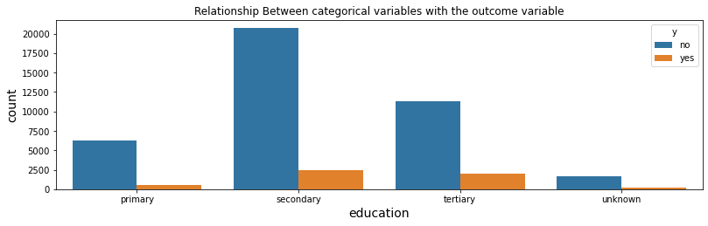
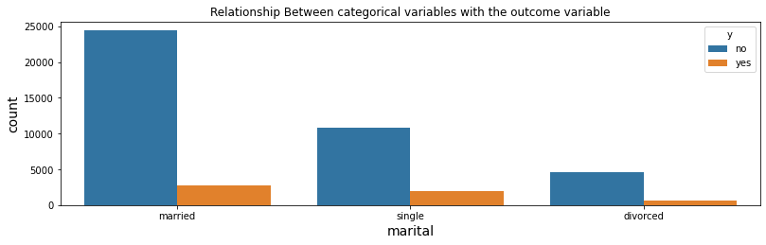
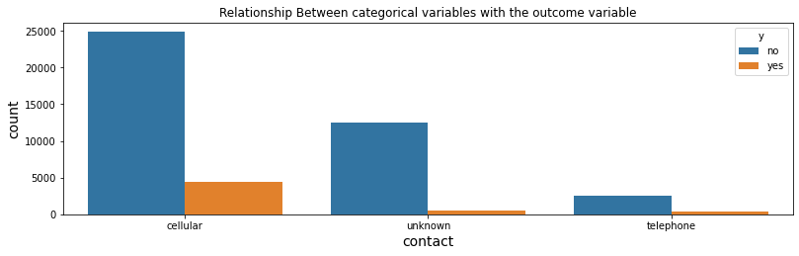
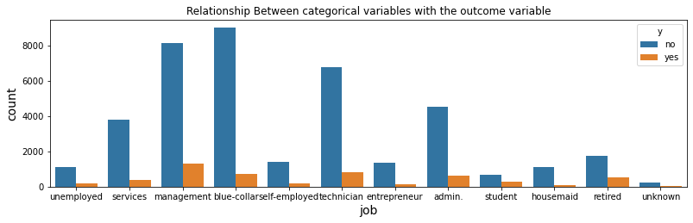
Finding Patterns between the categorical variables and target variable
Y (target variable, yes)
Education
Marital status
Job
Contact

Slide 9
Conclusion: To increase positive response rate from customers to open term deposit accounts, bank should focus on ----
Customers having administrative jobs and who are technicians
They are married. They hold a university degree.
Customers who are middle aged having grater balance values
Cell-phones should be the preferred mode of contact for contacting customers
Higher Contact call duration during this campaign

Slide 10


